Slide 1

Library Fine Calculator in C++
Object-Oriented Programming Approach

Slide 2
INTRODUCTION
Problem Statement
The Challenge
Libraries across India face significant challenges in managing overdue book returns and calculating fines accurately. Manual processes often lead to calculation errors, disputes with students, and administrative overhead.
Manual fine calculation is time-consuming and error-prone
Librarians must remember complex fine structures, handle multiple books simultaneously, and maintain accurate records. This process becomes especially difficult during peak hours when many students return books at once.
An automated solution is essential to streamline operations, reduce human error, and provide instant, transparent fine calculations that students can trust.

Slide 3
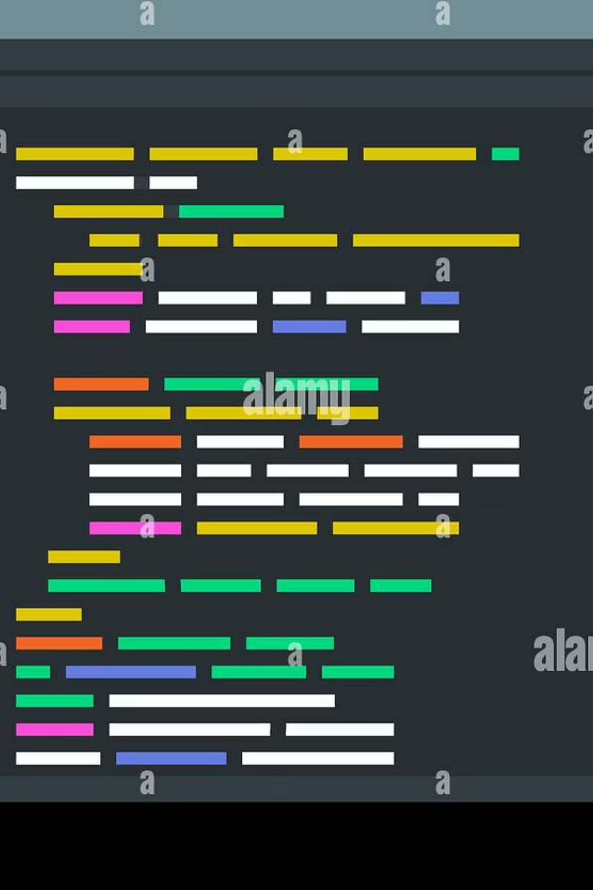
Programme Objective
Accept Book Details
Calculate Fine Automatically
Display Formatted Receipt
Capture book title and number of overdue days through user-friendly input interface
Generate clear, professional receipt showing all transaction details and amount due
Apply appropriate fine rules based on duration of delay using conditional logic

Slide 4






FINE STRUCTURE
Fine Calculation Rules
0 Days Overdue
No Fine – Book returned on time, no charges apply
1–5 Days Overdue
₹5 per day – Minimal penalty for short delays
6–10 Days Overdue
₹10 per day – Moderate penalty for extended delays
Above 10 Days Overdue
₹20 per day – Significant penalty for prolonged delays

Slide 5
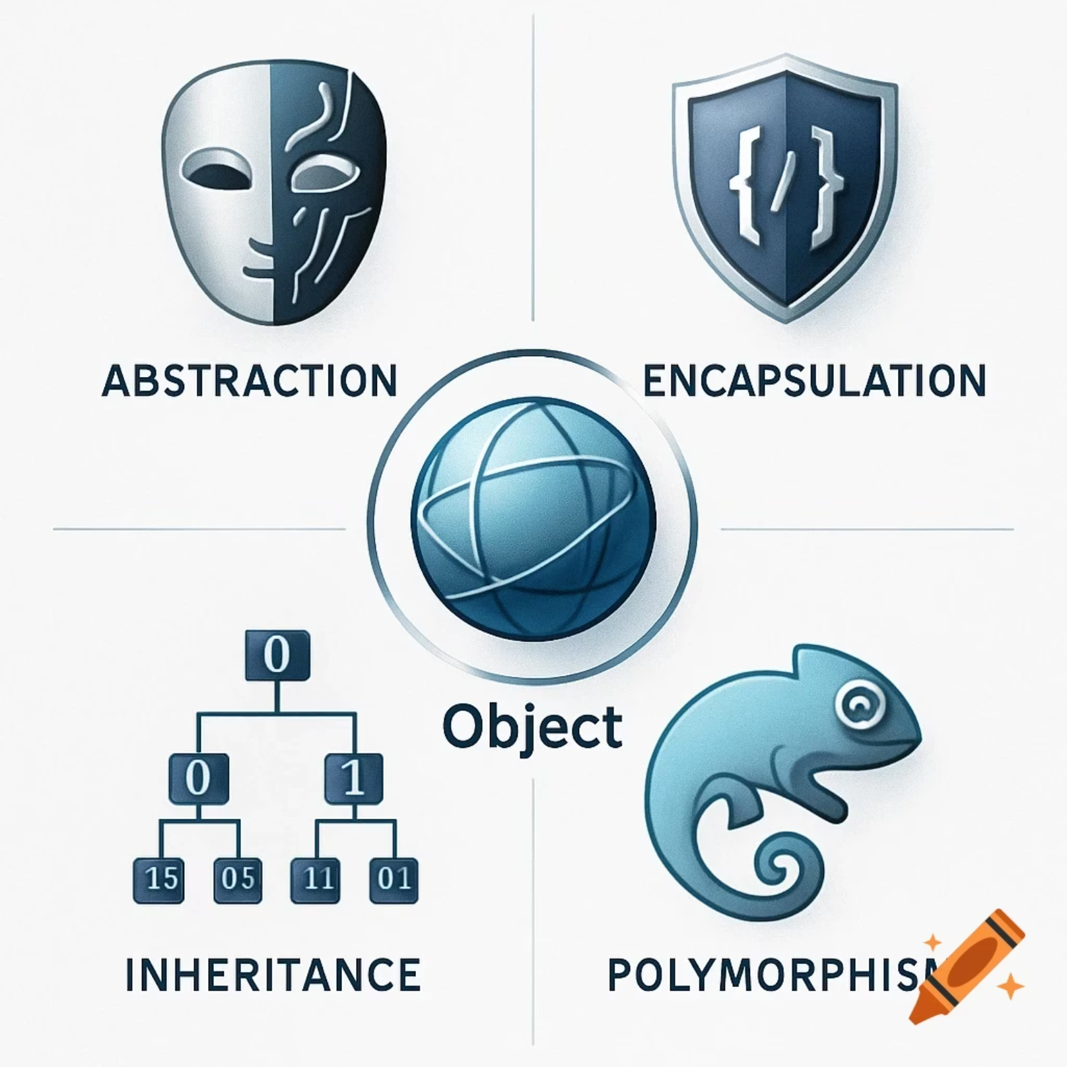
Core C++ Concepts Utilised
Classes & Objects
Encapsulation
Blueprint design pattern for creating reusable, organised code structures that model real-world entities
Data hiding mechanism protecting sensitive information whilst providing controlled access through public methods
Conditional Statements
Input/Output Streams
Decision-making logic using if-else structures to implement fine calculation rules based on overdue duration
Console interaction using cin and cout for user data collection and formatted output display

Slide 6
PROGRAMME ARCHITECTURE
Class Structure: LibraryFineCalculator
The programme utilises object-oriented design principles with a single, well-structured class encapsulating all necessary functionality for fine calculation and display.
Data Members
Member Functions
bookTitle (string): Stores the name of the borrowed book
daysOverdue (int): Records number of days past due date
totalFine (float): Calculates and stores the final fine amount
inputDetails(): Accepts book information from user
calculateFine(): Applies rules and computes fine amount
displayReceipt(): Formats and shows payment details

Slide 7

How the Programme Works
User Input
Display Receipt
Fine Calculation
The programme follows a simple, linear execution flow that ensures accurate fine calculation and clear communication with users.
01
02
03
User Input Phase
Fine Calculation Logic
Receipt Generation
The programme prompts the user to enter the book title as a string and the number of days overdue as an integer. Input validation ensures data integrity before proceeding to calculation.
Based on the overdue days entered, the programme uses nested if-else conditions to determine the appropriate fine rate. It multiplies the rate by the number of days to compute the total fine amount.
The calculated fine is displayed in a well-formatted receipt showing the book title, days overdue, applicable rate, and total fine in rupees. This provides transparency and serves as documentation.

Slide 8
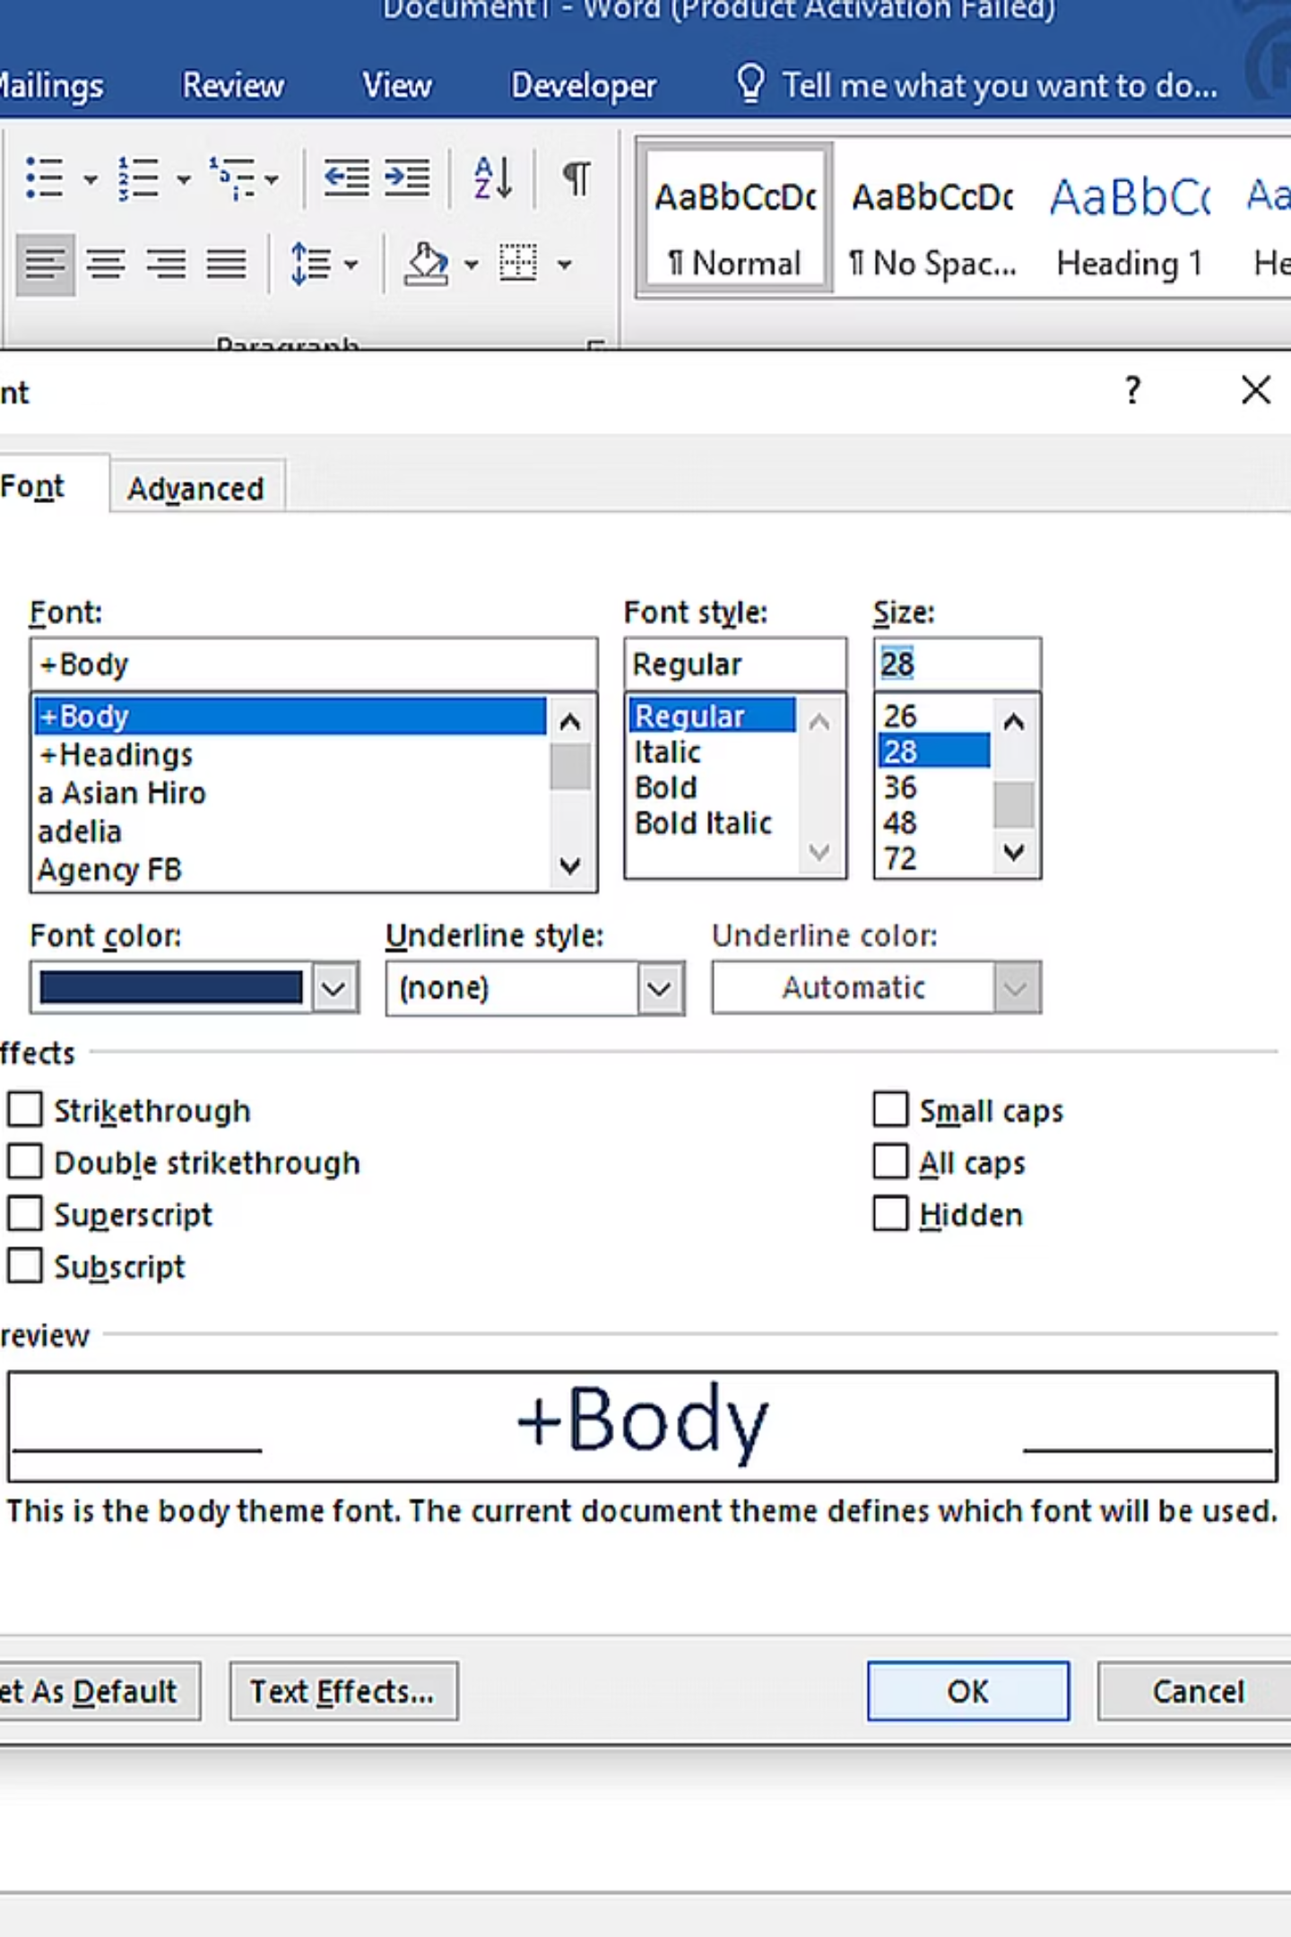
EXAMPLE
Sample Programme Output
Sample Input
Generated Receipt
Enter book title:
Data Structures in C++
Enter days overdue:
8
===== LIBRARY FINE RECEIPT =====
Book Title: Data Structures in C++
Days Overdue: 8 days
Fine Rate: ₹10 per day
Total Fine: ₹80
Please pay at the library counter.
================================
This example demonstrates how the programme handles a book that is 8 days overdue, falling into the 6-10 days category with a fine rate of ₹10 per day, resulting in a total fine of ₹80.

Slide 9
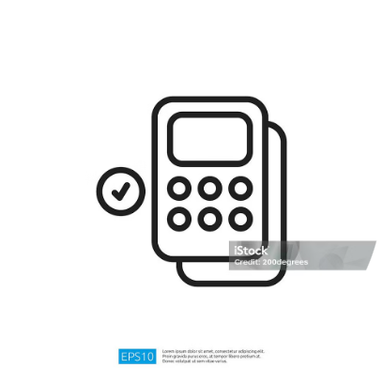

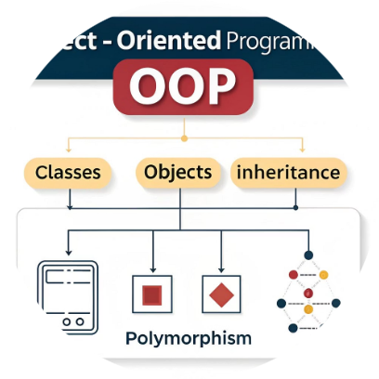

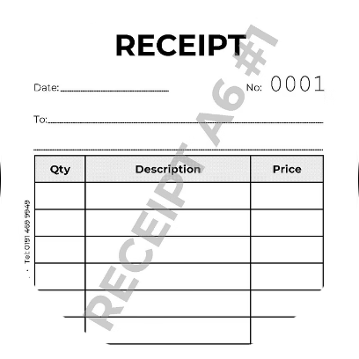
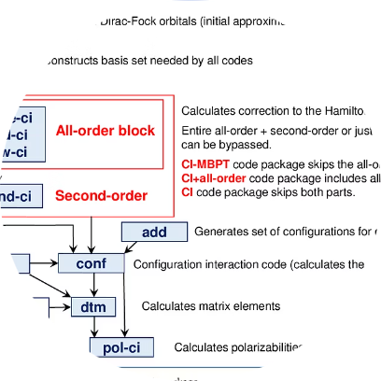
Advantages of the Programme
Accurate Fine Calculation
Easy to Use
Demonstrates OOP Principles
Time Efficient
Intuitive command-line interface requires minimal training for library staff. Simple prompts guide users through the entire process step by step.
Processes fine calculations instantly, saving valuable time during peak library hours and allowing staff to serve more students quickly.
Eliminates human errors in mathematical calculations and ensures consistent application of fine rules across all transactions, reducing disputes with students.
Serves as an excellent educational tool for students learning object-oriented programming concepts such as encapsulation, data abstraction, and method organisation.
Professional Documentation
Scalable Foundation
Well-structured code base makes it easy to add new features, modify fine rules, or integrate with other library management systems in the future.
Generates formatted receipts that provide clear transaction records, supporting accountability and transparency in library operations.

Slide 10

Conclusion & Future Scope
The Library Fine Calculator successfully demonstrates how object-oriented programming can solve real-world problems efficiently. This programme provides a solid foundation for automated library management whilst serving as an excellent learning resource for students.
Database Integration
Connect to MySQL or PostgreSQL to store historical fine records, enabling data analysis and reporting capabilities
Multiple Books Support
Extend functionality to handle multiple book returns simultaneously using arrays or vector data structures
Student Account System
Implement user authentication and maintain individual borrowing histories linked to student identification numbers
Web Interface
Develop a graphical user interface or web application to make the system accessible from any device on campus

